Slide 1
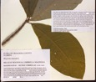
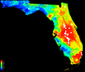
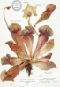
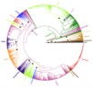
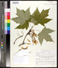
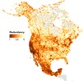
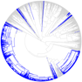
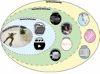
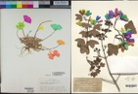


Case Studies:
How are researchers using deep learning?
Examples Using Herbarium Specimens
Pamela S. Soltis
University of Florida
Notes:
Thanks to a new program at NSF, more and more US collections are going online. UF is now home to iDigBio, the national center for digitization of biodiversity collections, which has the mission of coordinating digitization and databasing of US collections. iDigBio ingests, serves, and integrates data, such as locality information, date of collection, and images, from all natural history collections in the country.

Slide 2
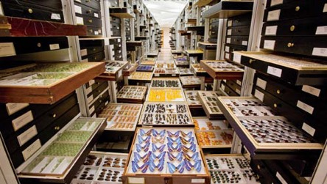
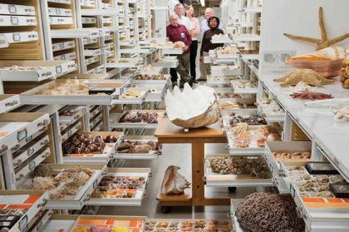
Museum Collections
~1,600 natural history collections
in the US
1-2 billion specimens
in the US
3-4 billion specimens worldwide
Smithsonian

Slide 3
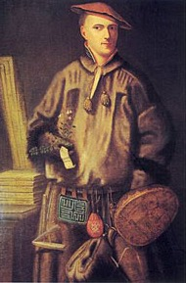
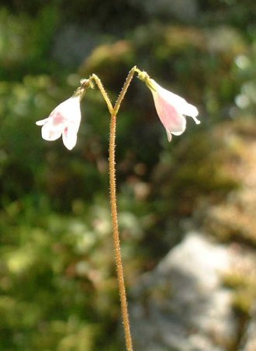
Systematics and Taxonomy
Linnea (twinflower)
Carl Linné, aka Carolus Linnaeus

Slide 4
Museum Collections
Genetics
Genomics
Chemistry…
…Species interactions
Phenology
Biogeography
More!
Smithsonian

Slide 5

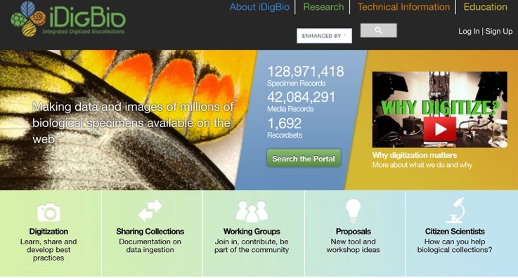
Digitized Data & Biodiversity Research
www.idigbio.org

Slide 6
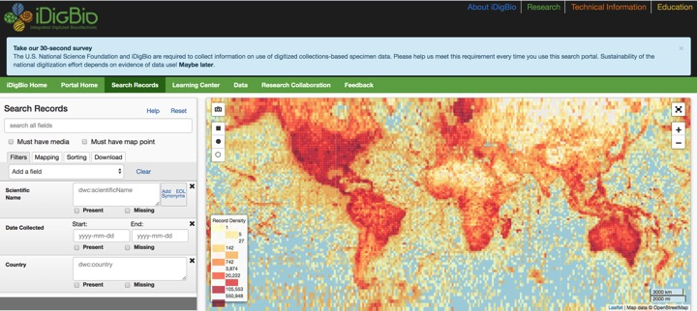
Digitized Data & Biodiversity Research
www.idigbio.org

Slide 7
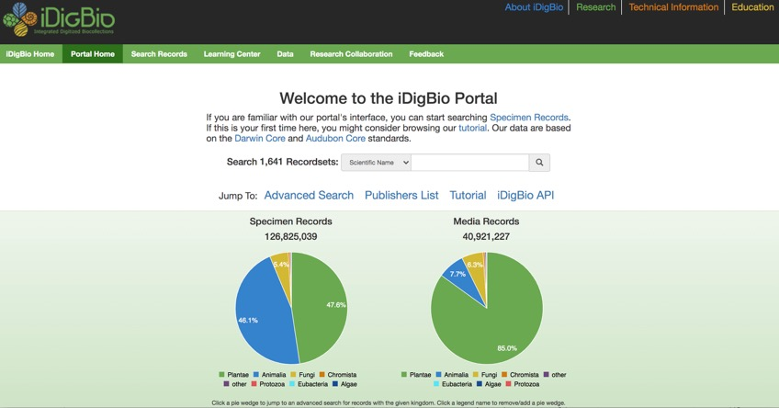
LOTS of Herbarium Specimens!

Slide 8
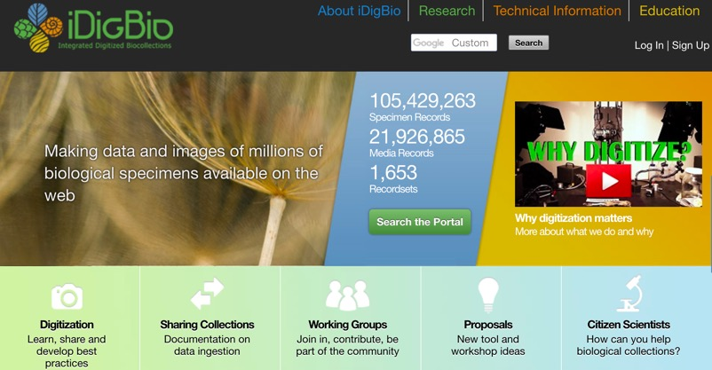

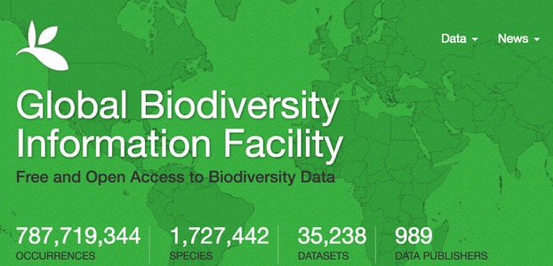




Other Aggregators

Slide 9

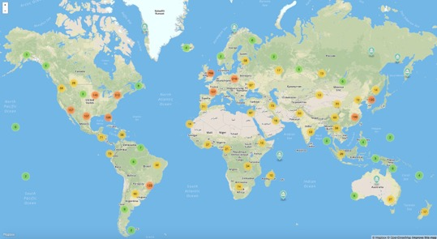
Herbaria Worldwide
3,400 herbaria
400,000,000 specimens!
Thiers 2020

Slide 10
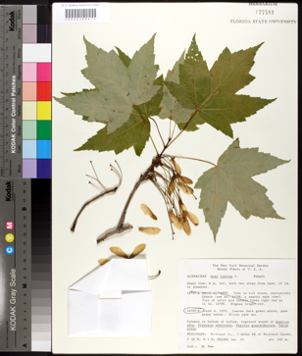

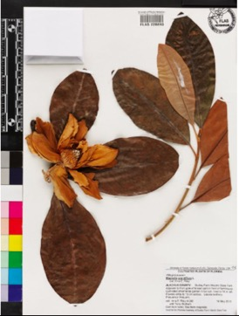

Slide 11
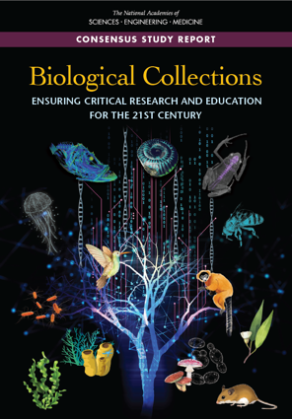
Role of Natural History Collections in Addressing Societal Challenges: Unanticipated Uses
Effects of global change on biodiversity
loss of biodiversity
invasive species
changes in land use
loss of ecosystem services
Food security
Emerging pathogens and other factors related to human health
Collected for one purpose, used for many others
The National Academies of
SCIENCES ENGINEERING MEDICINE

Slide 12



Artificial Intelligence
Notes:
But what if we didn’t have to score them by hand? What if we could apply the tools of artificial intelligence – the same general processes responsible for autocorrect on our phones and self-driving cars – to help us score herbarium specimens as being in flower or fruit?

Slide 13
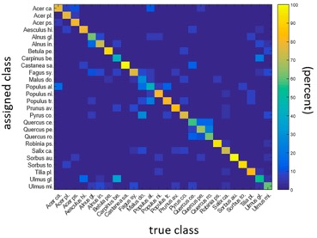
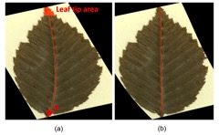
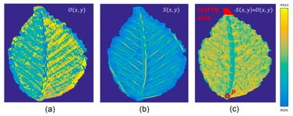
Machine Learning: Plant ID
Machine Learning: Herbarium specimens
Classifying German trees to species
Leaf shape, venation
85% accuracy
Unger et al. 2016

Slide 14
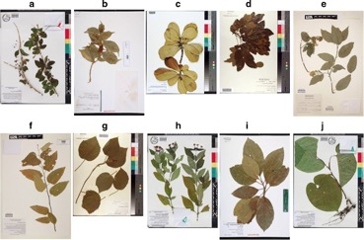
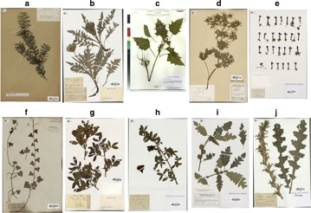
Machine Learning: Plant ID
Deep Learning: Herbarium specimens (2 data sets)
Classifying plants to species
>1200 species
250,000 images from iDigBio
90% accuracy
Carranza-Rojas et al. 2017

Slide 15
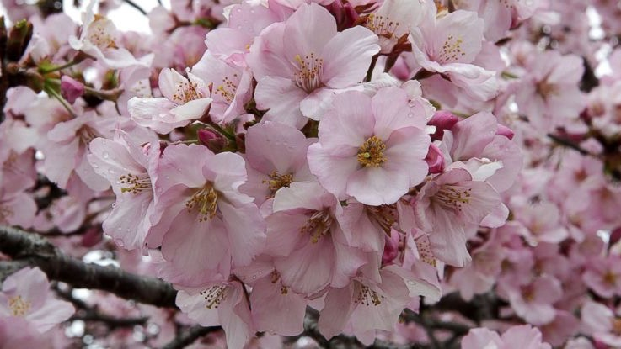
Phenology:
key seasonal changes in plants and animals from year to year—such as flowering, emergence of insects, and migration of birds—marker of climate change
Notes:
Climate change is not only affecting the distributions of species but also their annual cycles, something we refer to as phenology. For plants, phenology refers to such key seasonal changes as bud burst, flowering, and fruiting.

Slide 16
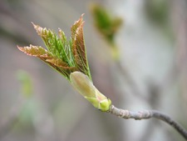
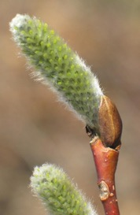
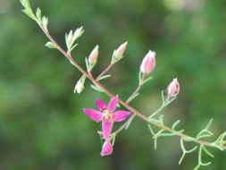
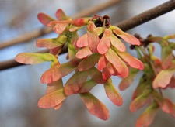
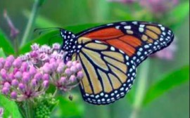
Phenology: Bud Burst, Flowering, Fruiting
NPN, www.sbs.utexas.edu, www.sites.psu.edu

Slide 17
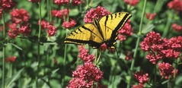
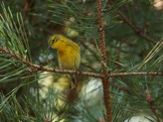
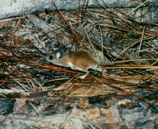
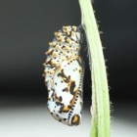
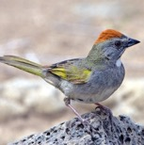
Phenology in Other Organisms
Insect Emergence, Bird Nesting & Migration,
and Phenological Synchrony/Asynchrony
Bartomeus et al. 2011
http://pheno-mismatch.org/
http://budburst.org/phenology_whyphenology

Slide 18

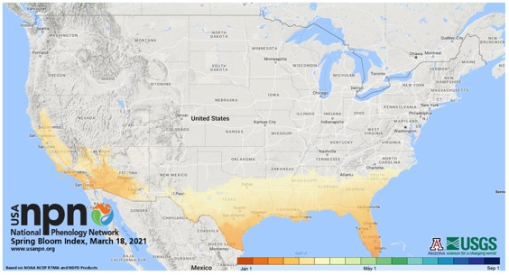
Notes:
The National Phenology Network tracks patterns and timing of phenological change each year across the country. This maps shows the extent of first flowering for a select list of species, as of yesterday. Darker colors in the south indicate that first flower occurred longer ago, and regions in gray are areas where flowering hasn’t yet begun. We can look at a pattern like this and wonder how this compares with other years – is this a typical year?

Slide 19
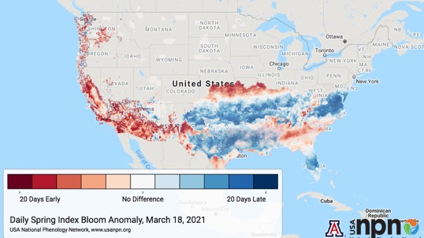
Notes:
This map shows differences from average – with red showing earlier than normal first flowering – which we see in the Southwest and into the Plains and a bit in the Southeast - and also later than normal – in blue – in parts of Florida and other parts of the South, into Virginia.

Slide 20
40 years
limited species
Notes:
These maps are compilations of data for the past 40 years and for a specific set of species. And they tell us how plants are responding in terms of flowering time to a changing climate. But what if we could look at more species and go back earlier in time?

Slide 21
Notes:
in fact, herbarium specimens allow us to do just that, because each specimen has its date of collection. And we can tell from the specimen if it was in flower like this Magnolia or this pitcher plant or in fruit like this maple. Herbarium specimens provide data for more species and over longer periods of time than the observations collected by the NPN.

Slide 22

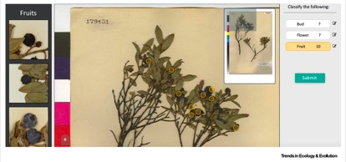
Phenological Data from Labels and Images
Phenological data – as described in label notes
“tree in full fruit…”
or from image itself:
CrowdCurio, in
Willis et al. 2017

Slide 23
Machine Learning and Phenology
Deep learning annotation
3 herbarium data sets:
163,233 specimens
7782 species, 236 families
Fertility
96.3% accurate
Lorieul et al. 2019

Slide 24
Machine Learning: Plant ID
Machine Learning and Phenology
Flowers
83.9% accurate
Fruits
81.3% accurate
Lorieul et al. 2019

Slide 25
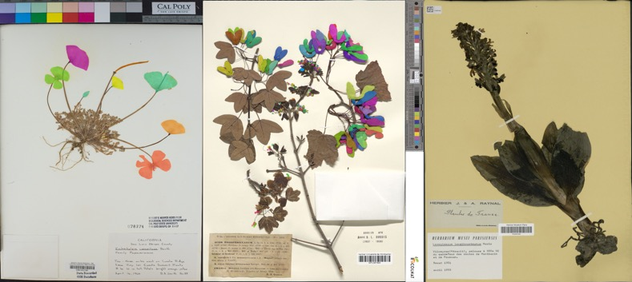
Segmentation Masks Delimit Reproductive Structures
Pearson et al. 2020

Slide 26
Machine Learning & Plant Biology:
Special Issue of APPS (2020)
June: Herbarium Specimen Images
Phenology (2)
Morphology
Herbivory
Species Identification (2)
Software: Leaf Detection
Software: Leaf Recognition and Measurement
Edited by P. Soltis, G. Nelson, A. Zare, E. Meineke

Slide 27
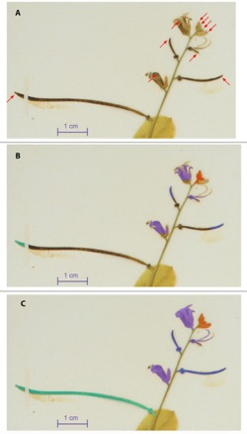
Testing Deep Learning Models for Phenological Analysis
Automate the detection, segmentation, classification of reproductive structures
flower buds, flowers, immature fruits, and mature fruits
Streptanthus tortuosus (Brassicaceae)
Training data: 21 digitized herbarium sheets, 1036 reproductive structures
mask R-CNN (regional convolutional neural network)
Goeau et al. 2020

Slide 28
Testing Deep Learning Models for Phenological Analysis
Performance of detection and segmentation varies significantly:
the type of annotations used for training
the type of reproductive structures
the size of the reproductive structures
Quite accurate estimates (77.9% of cases) of number of reproductive structures
Goeau et al. 2020

Slide 29
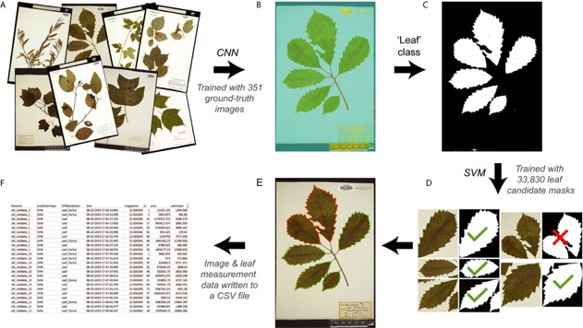
Machine Learning and Leaf Analysis
LeafMachine: Using machine learning to automate leaf trait extraction from digitized herbarium specimens
Weaver et al. 2020

Slide 30
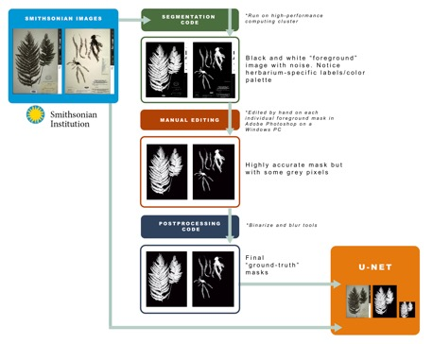
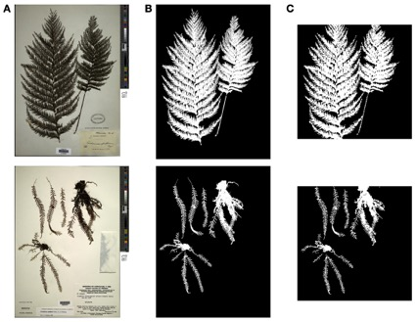
Machine Learning, Segmentation Masks, and Morphology
automated
original
ground-
truthed
White et al. 2020

Slide 31
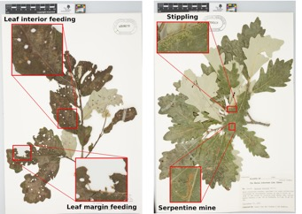
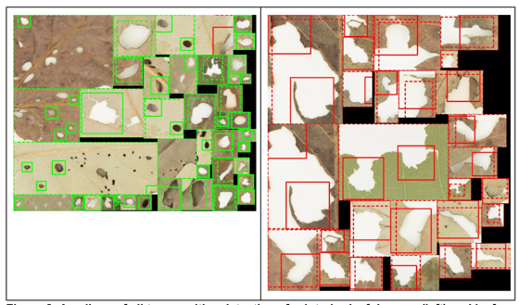
Machine Learning and Herbivory
Types of Herbivory
Successful Detection
Dash = human Solid = machine
Interior
Margin
Meineke et al. 2020

Slide 32
Machine Learning and Morphology
Distinguishing among Equisetum hyemale, E. laevigatum, and E. xferrissii
Nodal leaf sheath characters
2 dark stripes
rim barely wider than internode above
persistent or deciduous teeth
1 stripe where teeth abscised
rim wider than internode above
deciduous teeth
Pryer et al. 2020
E. hyemale
E. laevigatum

Slide 33
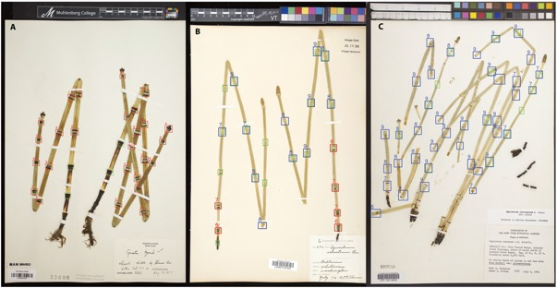
Machine Learning and Morphology
Classifiers correctly
detected nodes
distinguished them as E. hyemale type (red) or E. laevigatum type (blue)
detected both types on the hybrid
performed tasks 90% of the time
Very promising for future work
E. hyemale
E. xferrissii
E. laevigatum
Pryer et al. 2020

Slide 35



Summary
Multiple machine learning applications
Plant identification
Phenology: bud burst, flowering, fruiting time
Leaf detection
Morphology
Herbivory
More!

